Slide 1
Operating Systems Basics
Operating Systems
Notes:
Introduction to the presentation on Operating Systems Basics.

Slide 2

Introduction
Operating Systems manage computer hardware and software resources efficiently always
Introduction to Operating Systems involves understanding basic concepts and terminology clearly
Operating Systems act as intermediaries between users and computer hardware components always
Basic functions of Operating Systems include process management and memory allocation techniques
Operating Systems provide platform for running application software and utilities smoothly
Introduction to Operating Systems covers types of Operating Systems and their characteristics
Operating Systems basics include understanding of kernel and user space interactions clearly
Fundamental principles of Operating Systems involve multitasking and multithreading concepts
Operating Systems basics also cover file systems and storage management techniques effectively
Understanding Operating Systems basics is essential for software development and programming tasks
Notes:
Explain Introduction in the context of Operating Systems Basics.

Slide 3
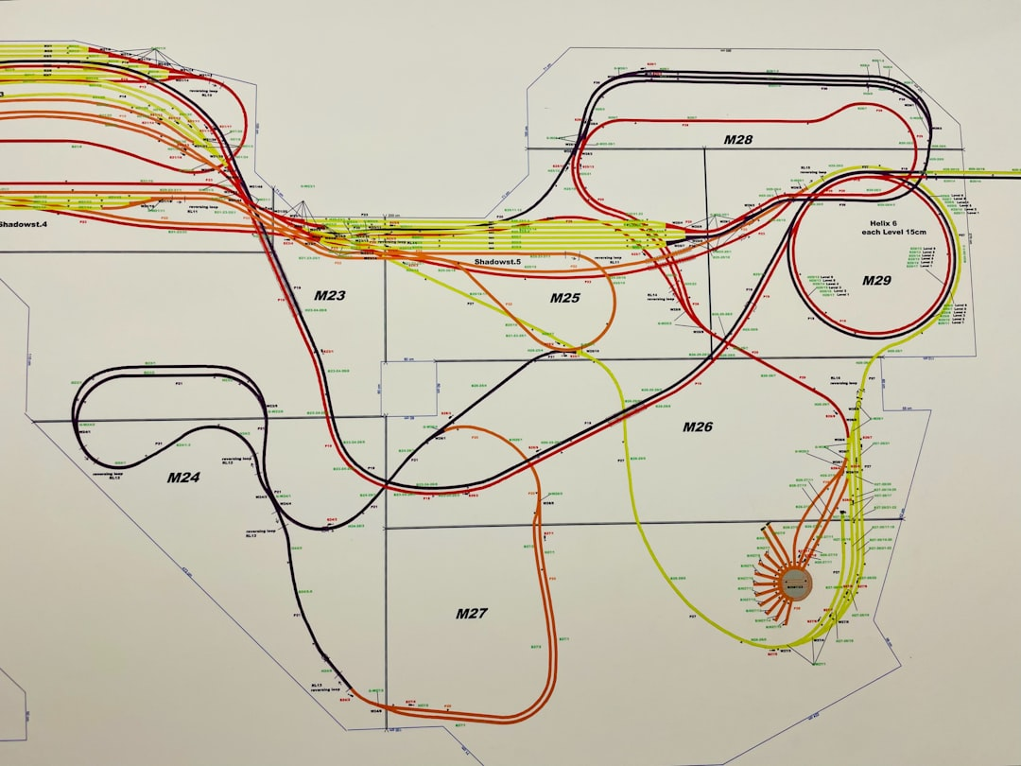
Core Concept / Architecture
Operating Systems manage computer hardware resources efficiently and effectively always
Core concept involves process management and memory allocation techniques always
Multitasking and multithreading are key architectural features of modern Operating Systems
Kernel is the central component of an Operating System architecture design
Device drivers interact with hardware components and manage data transfer processes
System calls provide interface between applications and Operating System services always
Virtual memory enables efficient use of physical memory and storage resources
File systems manage data storage and retrieval operations on storage devices
Networking architecture enables communication between devices and systems over networks
Security features protect Operating System and user data from unauthorized access
Notes:
Explain Core Concept / Architecture in the context of Operating Systems Basics.

Slide 4
Mathematical / Logical Explanation
Algorithms and data structures form the foundation of operating system design and development processes always
Boolean logic and set theory apply to operating system security and access control mechanisms effectively
Computer architecture and mathematics influence operating system performance optimization techniques greatly always
Discrete mathematics and graph theory explain operating system scheduling and resource allocation algorithms clearly
Formal language theory and automata help operating system designers create efficient parsing and compilation methods
Graph theory and combinatorics are essential for operating system network topology and protocol analysis always
Mathematical modeling and simulation aid operating system researchers in predicting system behavior accurately always
Number theory and cryptography enable secure operating system authentication and encryption mechanisms always
Probability and statistics are crucial for operating system reliability and fault tolerance analysis always
Set theory and category theory provide a mathematical framework for operating system specification and verification
Notes:
Explain Mathematical / Logical Explanation in the context of Operating Systems Basics.

